Slide 1
City growth and Zipf’s Law
Hélène van Heijningen & Matthijs Brouns
CPB: Bureau for Economic Policy Analysis

Slide 2
Contents
CPB and Zipf’s law
Research question & Approach
Narrative
Model logic
Verification & Validation
Experimental design
Model experimentation
Conclusions
Future research
Netlogo in practice

Slide 3
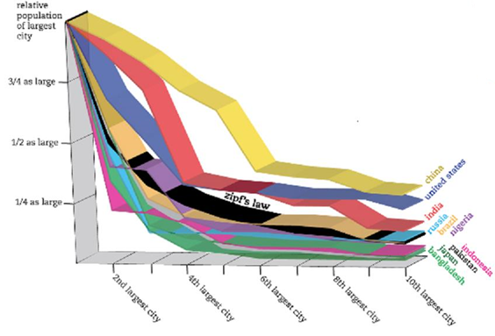
CPB and Zipf’s Law
The largest cities in a country show a Zipfian distribution

Slide 4
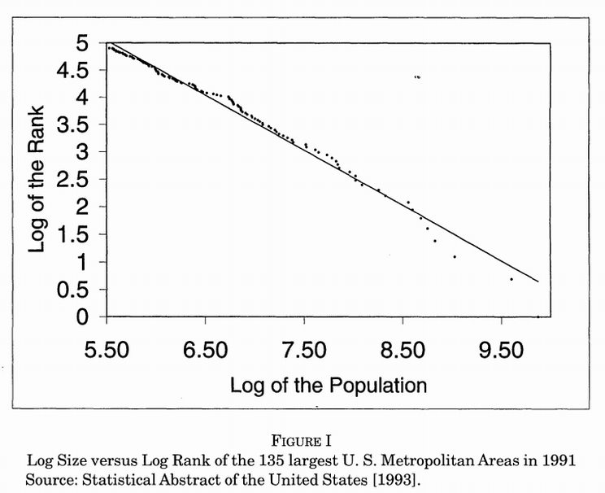
CPB and Zipf’s Law
The largest cities in a country show a Zipfian distribution

Slide 5
CPB and Zipf’s Law
CPB:
Can we influence this type of city growth?
Can we design policies knowing this type of behaviour occurs?
What causes the Zipf’s law to emerge?

Slide 6
Research question & Approach
Focus: Decisions made on household level
Research question:
How do decisions made at household level influence moving behaviour between cities to cause the emergence of the Zipf’s law?
Approach:
Literature research: for what reasons do people move?
Stage of Life
Job opportunities

Slide 7
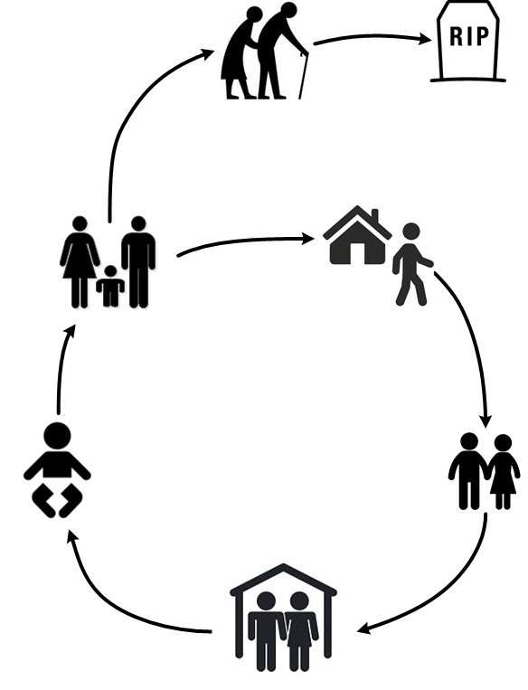
Narrative
65+ Move less and prefer the countryside
Children (16-23) move out to more attractive city, a new household is formed
Young adults move
very often
Life cycle
Couples (23-40) reproduce, their household grows
Couples form in
the same city,
households merge

Slide 8
Narrative
Having children
Borrowed utility
City size
(facilities)
Age
Moving?
Distance from current location
Time since moving
Life cycle
Job attractiveness

Slide 9
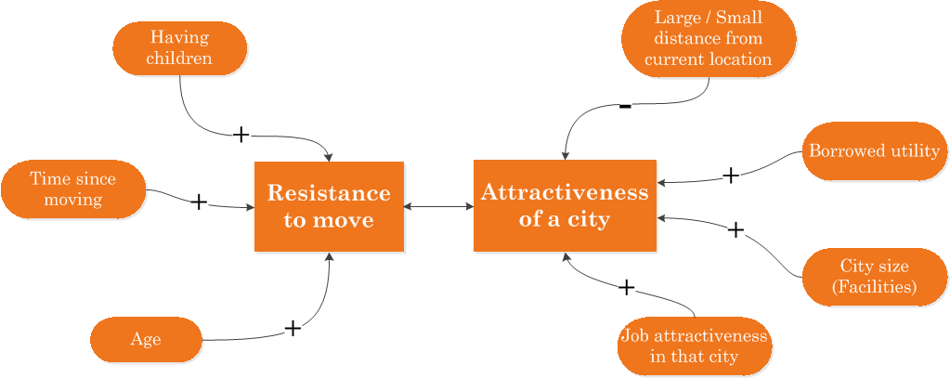
Model Logic
Rule: A household moves to a random city for which its ‘Attractiveness’ > ‘Resistance to move’

Slide 10
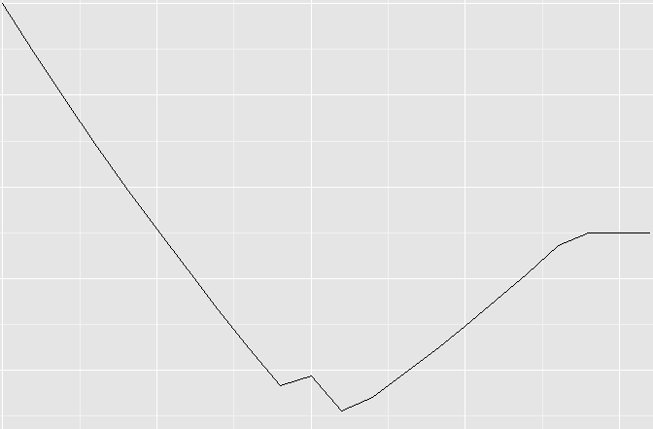
Model Logic: Resistance to Move
Gradually declining slope due to change in age of household members.
Resistance to move
Plateau reached
Childbirth
Time since moving

Slide 11
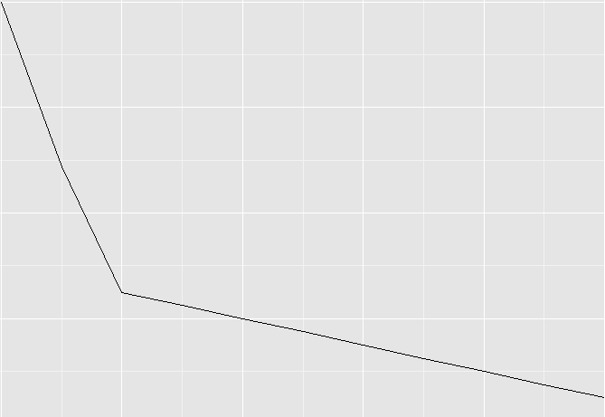
Model Logic: Job Attractiveness
Job attractiveness
Primary
sector jobs
Secondary
sector jobs
Tertiary
sector jobs
Quaternary
sector jobs
Attractiveness
City occupancy rate

Slide 12
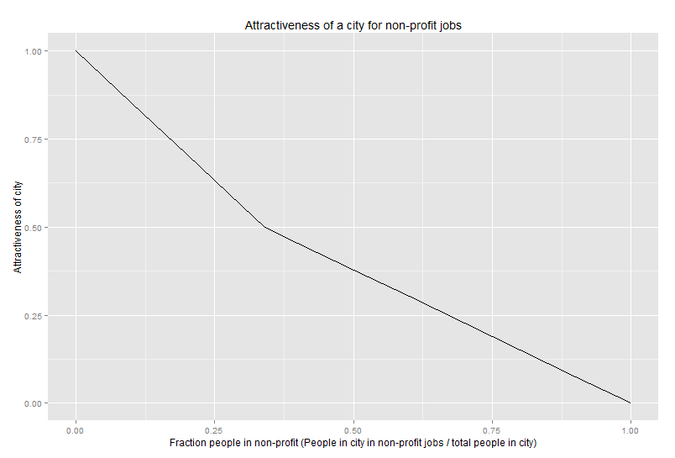
Model Logic: Job Attractiveness
Job attractiveness
Primary
sector jobs
Secondary
sector jobs
Tertiary
sector jobs
Quaternary
sector jobs
Attractiveness
Fraction people in 2nd or 4th sector jobs

Slide 13
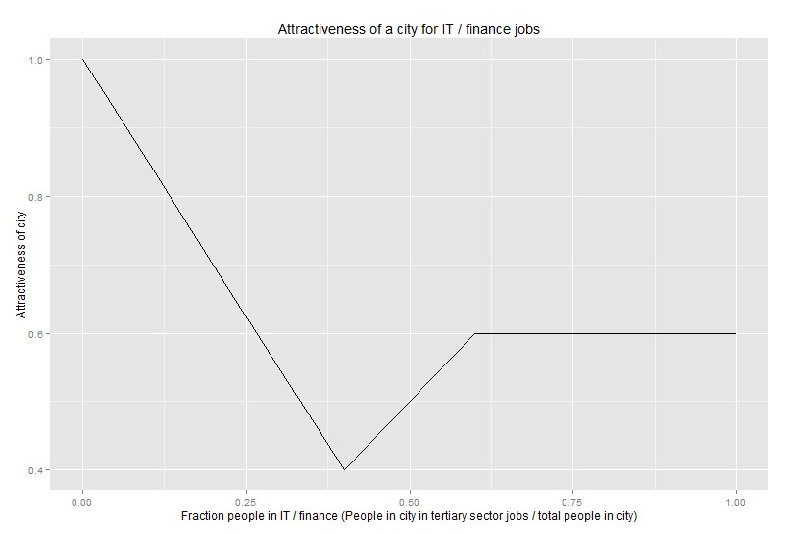
Model Logic: Job Attractiveness
Job attractiveness
Primary
sector jobs
Secondary
sector jobs
Tertiary
sector jobs
Quaternary
sector jobs
Attractiveness
Service-like
effect
Specialization effect
Fraction people in 3rd sector jobs

Slide 14
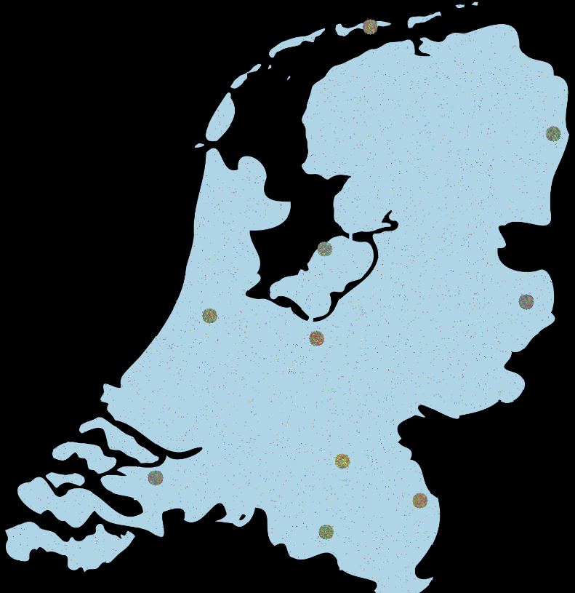
Model Output
Map with randomly
distributed cities
Households distributed
over cities & countryside
For every tick (1 year)
Total number of households
Number of households in and out of cities
Number of households for the 10 different cities

Slide 15
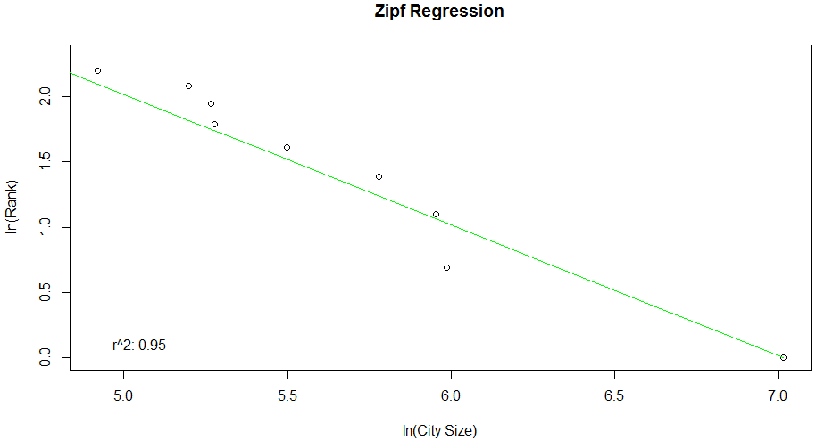
Model Output

Slide 16
Verification & Validation
Verification
6 Tests on a single-agent, minimal interaction and multi-agent level
The model is implemented as intended
Literature validation
Parameters and relations are based on literature
Face validation through expert consultation
Assumptions
Relations
Concepts

Slide 17
Experimental Design
Which variables have the most influence on creating the desired model output?
Multi-variate analysis
Latin hypercube
Because of long run time, limited number of runs (300)
Compare R-squared to a pure Zipfian distribution
R-squared > 0,80 found in literature

Slide 18
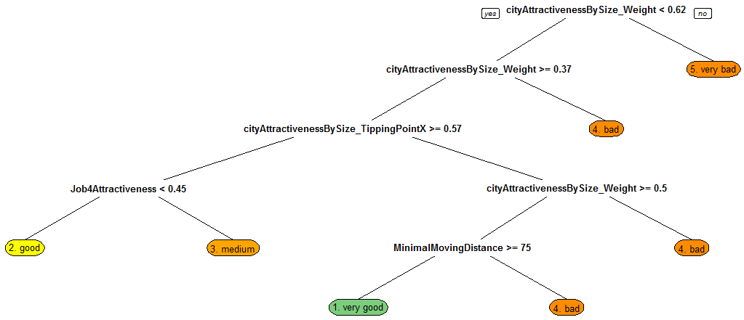
Model Experimentation

Slide 19
Model Experimentation
1/3 of the runs R-squared > 0,8
Verified by running the model again, with the outputs of the decision tree as an input space
These runs showed quite a lot of runs concurrent with the Zipf’s law compared to the base runs

Slide 20
Conclusions
Our model is able to produce cities according to a Zipfian distribution
However, very specific parameter values are needed to obtain a Zipfian distribution
The Zipf’s law has been around for centuries
Two variables seem to have the most effect:
The city size effect
Distance between cities
Do we now understand why a Zipf’s law emerges?

Slide 21
Future Research
Why doesn’t the Zipf’s law fit as well in the Netherlands as it does abroad and how does this affect decision making?
What happens when European borders disappear entirely?
Will Paris or London become the most important city?
What will happen to our cities?

Slide 22
Netlogo in Practice
Netlogo is all about turtles, and it moves about as fast as one
Too much time spent on making model run at reasonable speeds
Table implementation 100x slower than regular list
Subtracting sets undoable
No support for unit testing or assertions
Memory leaks in RNetlogo
Overall unsuitable due to speed limitations

Slide 23
Model files & Referenes
If you’re interested in the model files and documentation, please visit:
https://github.com/MBrouns/Zipfs-Law-and-city-development
References
Newitz, A. 2013. A mysterious law that predicts the size of the world’s biggest cities. Retrieved from: http://io9.com/the-mysterious-law-that-governs-the-size-of-your-city-1479244159 at the 6th of January, 2015.
Infrastructurist. 2011. A Capital On The Move. Retrieved from http://keith-travelsinindonesia.blogspot.nl/2011/06/capital-on-move.html at the 20th of January, 2015.

